Slide 1
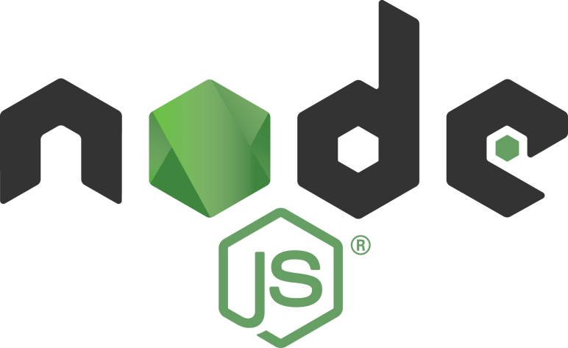
Introduction

Slide 2

Node.js® is a JavaScript runtime built on Chrome's V8 JavaScript engine (written in C++). Node.js uses an event-driven, non-blocking I/O model that makes it lightweight and efficient. Node.js' package ecosystem, npm, is the largest ecosystem of open source libraries in the world.
A platform which allows us to run Javascript on computer/server.
Read, delete & update files.
Easily communicate with database.

Slide 3
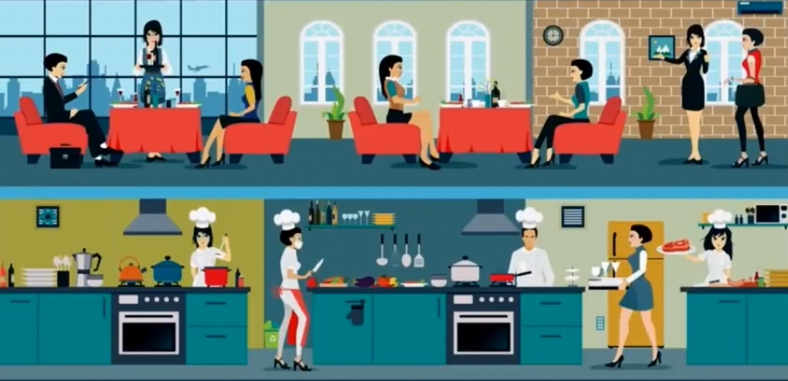
Synchronous vs Asynchronous
Blocking vs Non-Blocking
Basically, nodeJS is asynchronous!

Slide 4


SetUp
Visual Studio Code
Download & install here:
code.visualstudio.com
Node.Js
Download & install here:
nodejs.org
$ node --version
$ node -v

Slide 5
Require a Module
satu.js
var nama = 'Andi';
console.log(nama);
=======================
dua.js
require('./satu.js');
//require('./satu');
*Run dua.js!

Slide 6
Require a Var
satu.js
var nama = 'Andi';
module.exports = nama;
=======================
dua.js
var siapa = require('./satu');
console.log(siapa);
*Run dua.js!

Slide 7
Require a Fn
satu.js
var nama = function(x){
return nama = x + ' Susilo'
};
module.exports = nama;
=======================
dua.js
var siapa = require('./satu');
console.log(siapa('Andi'));
*Run dua.js!

Slide 8
Require Multiple Var #1
satu.js
var nama = 'Andi';
var usia = 26;
module.exports.nama = nama;
module.exports.usia = usia;
==========================
dua.js
var data = require('./satu');
console.log(data.nama);
console.log(data.usia);
*Run dua.js!

Slide 9
Require Multiple Var #2
satu.js
module.exports.nama = 'Andi';
module.exports.usia = 26;
==========================
dua.js
var data = require('./satu');
console.log(data.nama);
console.log(data.usia);
*Run dua.js!

Slide 10
Require Multiple Var #3
satu.js
var nama = 'Andi';
var usia = 26;
module.exports = {
nama: nama,
usia: usia}
==============================
dua.js
var data = require('./satu');
console.log(data.nama);
console.log(data.usia);
*Run dua.js!

Slide 11
Introduction to

